Slide 1
Compiler Construction
COMP 7.1
Unit 3

Slide 2

Course Outcomes
Course Outcome No. | CO Description | Cognitive Level
COMP 7.1.1 | Define the components and phases of the compiler, and the types of parsers. | CL1
COMP 7.1.2 | Explain the components and phases of the compiler. | CL2
COMP 7.1.3 | Apply algorithms to design a lexical analyser, construct a parser by hand, generate intermediate code and target code. | CL3
COMP 7.1.4 | Write a LEX/YACC specification for a given Regular Expression and use the LEX/YACC tool. | CL3
Compiler Construction

Slide 3
Unit 3 Syllabus
Intermediate Code Generation Questions
Run-Time environments
Questions
Symbol tables Questions
The content of a symbol table
Error detection and recovery Questions
Declarations
Assignment statements
Boolean expressions
Source language issues
Storage organization
Case statement
Procedure call
Storage-allocation strategies
Data structures for Symbol Table
Representing scope information
Syntactic phase errors
Semantic errors
Lexical phase errors
Intermediate Language

Slide 4
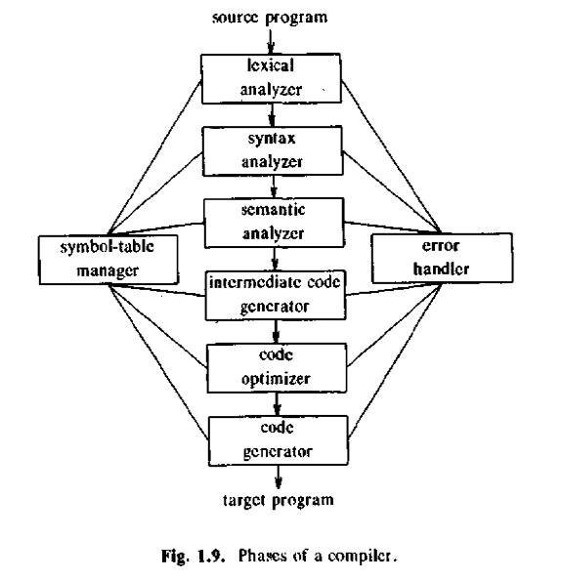
Unit 3

Slide 5
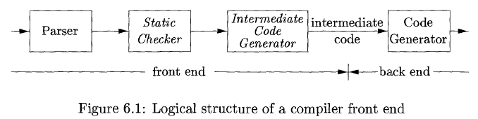
Chapter 8: Intermediate Code Generation (ICG)

Slide 6
Benefits of using a machine-independent intermediate form are:
Retargeting is facilitated; a compiler for a different machine can be created by attaching a back end for the new machine to an existing front end
Machine-independent code optimizer can be applied to the intermediate representation

Slide 7
8.1 Intermediate languages
Intermediate representations:
Syntax trees
Postfix notation
Three-address code

Slide 8
Graphical Representations
Syntax Tree
DAG
Postfix notation

Slide 9
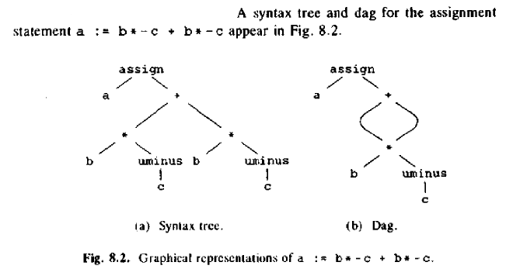
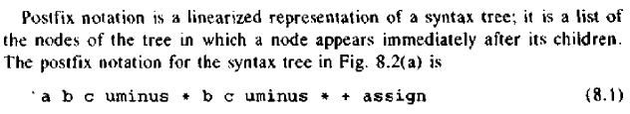

Slide 10
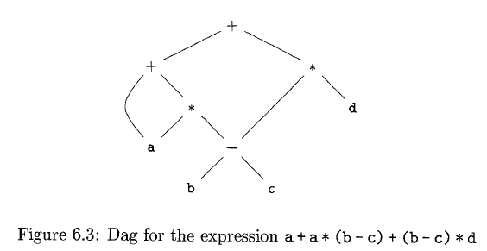

Slide 11
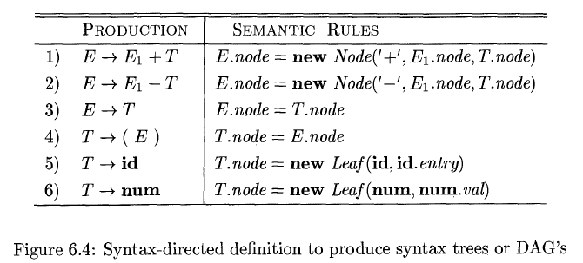

Slide 12
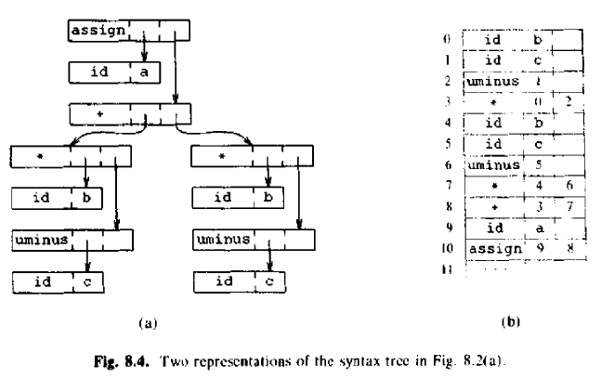
1

Slide 13
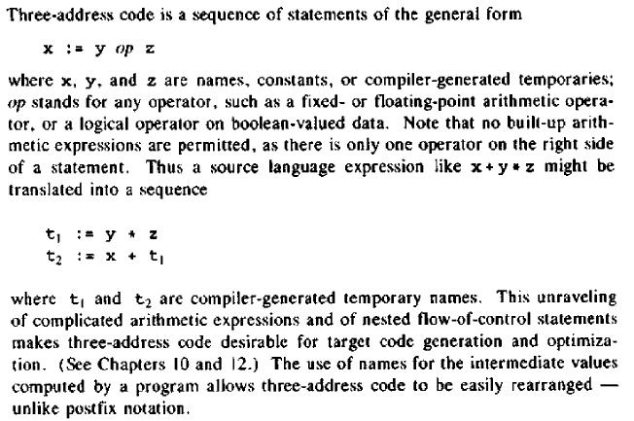
Three-Address code

Slide 14
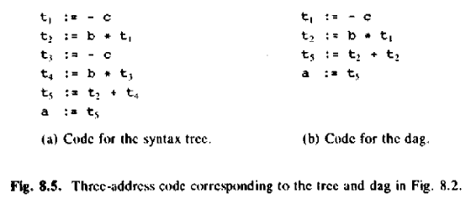
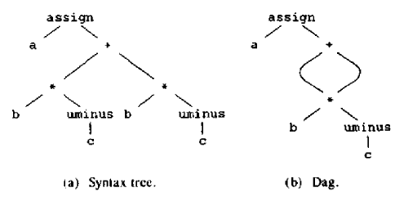

Slide 15
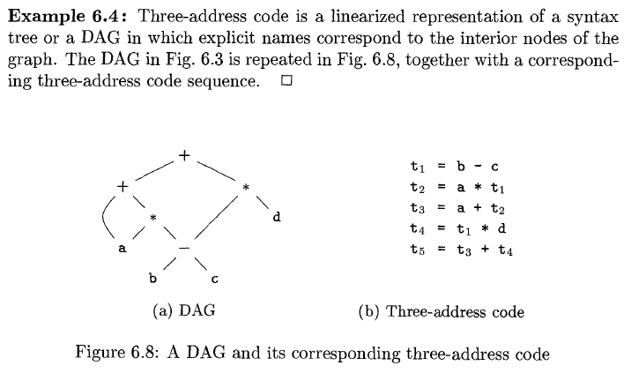

Slide 16
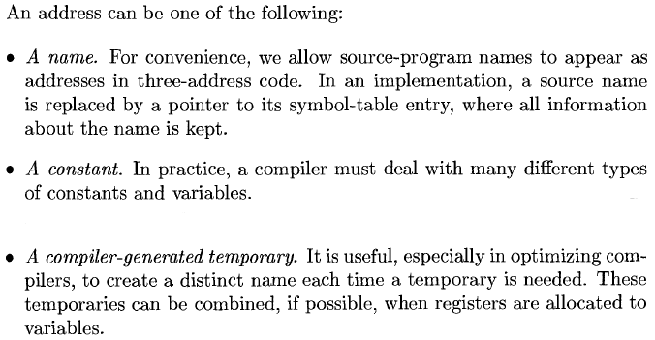

Slide 17
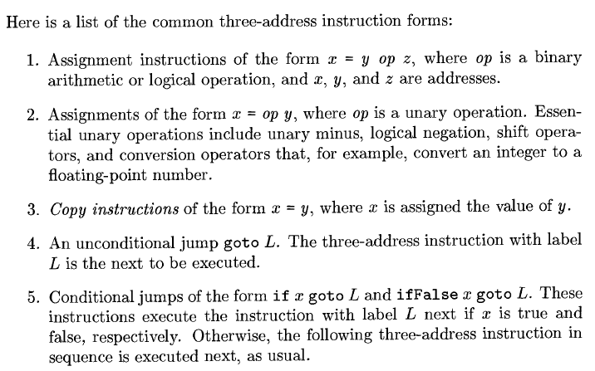

Slide 18
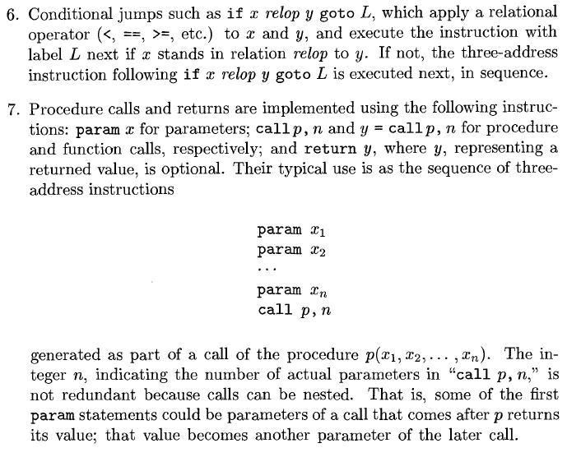

Slide 19
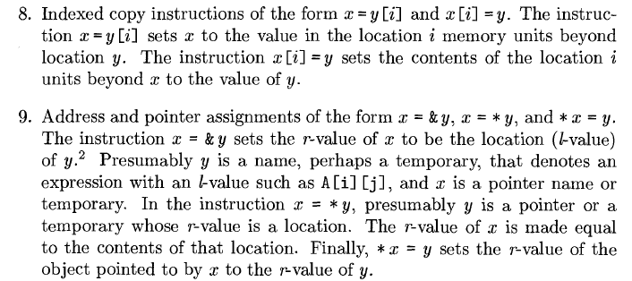

Slide 20
Background Ch. 2.3
To translate a PL construct, a compiler needs to keep track of:
Code generated for the construct
Type of the construct
Location of the first instruction in the target code
No. of instructions generated
Nos. 2-4 are the attributes associated with constructs
NTs and Ts have a set of attributes
Production has a set of semantic rules for computing the values of the attributes of the NTs and Ts in the production

Slide 21
Input ‘x’ sentence
-> construct using CFG
-> Parse tree for ‘x’
-> Apply semantic rules to evaluate attributes at each node in tree.

Slide 22
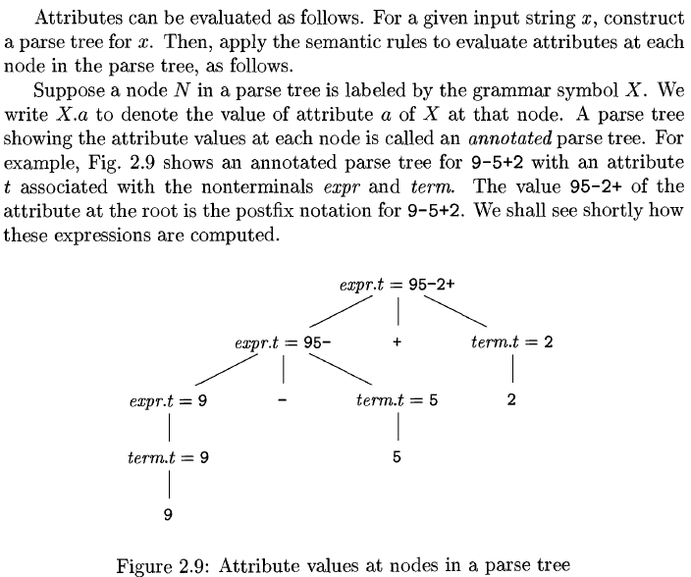

Slide 23
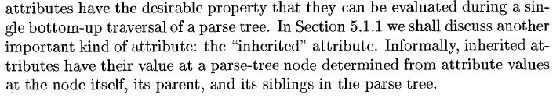

Slide 24
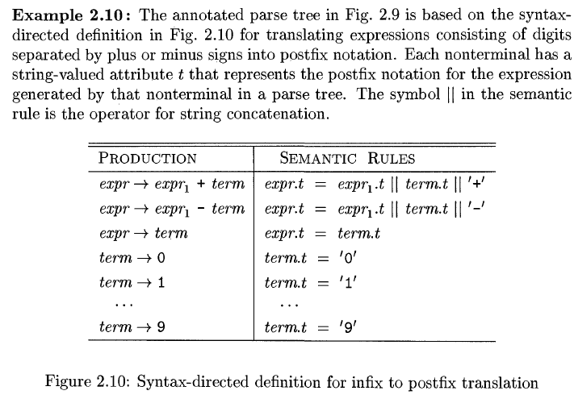

Slide 25
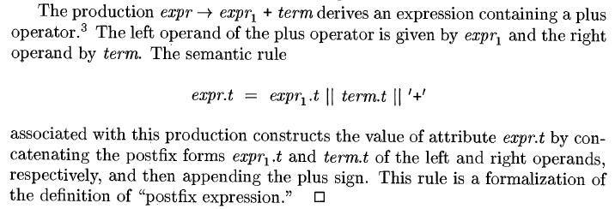

Slide 26
A Syntax-directed definition (SDD) specifies the translation of a construct in terms of attributes associated with its syntactic components
SDT are used to simplify many of the translations that take place in the front end of a compiler
Translation scheme is a procedural notation for specifying translations in terms of attributes associated with its syntactic components
SDT:
uses a CFG to specify the syntactic structure of the input
With each grammar symbol, it associates a set of attributes
With each production, it associates a set of semantic rules for computing values of the attributes associated with the symbols appearing in that production
The grammar and the set of semantic rules constitute the Syntax Directed Definition

Slide 27
A translation is an I/O mapping
Input: sentence of tokens as a parse tree
Function: Maps production to semantic action
Output: Intermediate code
A translation scheme is a CFG in which program fragments called semantic actions are embedded within the right sides of productions.
SDT shows the order of evaluation
It generates an output for each sentence ‘x’ generated by the underlying grammar by executing the actions in the order they appear during a Depth-First Traversal of a parse tree for ‘x’
|| -> concatenation

Slide 28
Syntax-Directed Translation (SDT) into Three-Address Code (TAC / 3AC)
When TAC is generated, temporary names are made up for the interior nodes of a syntax tree
The value of NT ‘E’ on the left side of E -> E1 + E2 will be computed into a new temporary t.
In general, the TAC for id := E consists of code to evaluate E into some temporary t, followed by the assignment id.place :=t

Slide 29
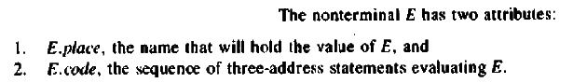

Slide 30
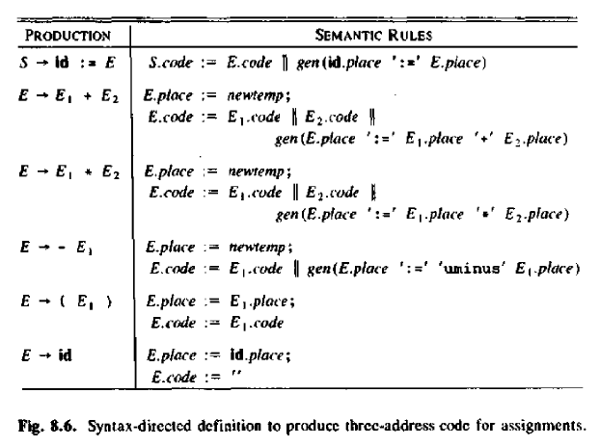
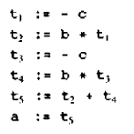

Slide 31
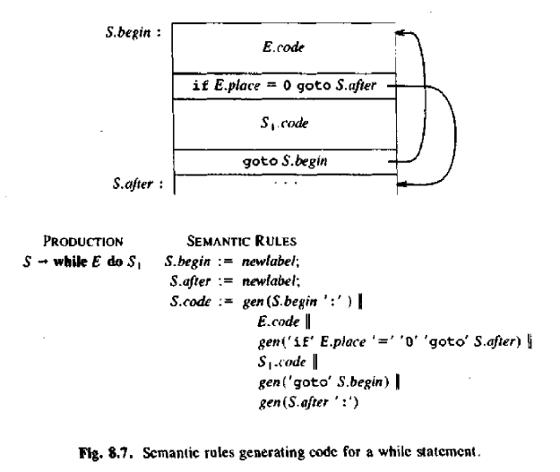

Slide 32
Implementations of Three-Address Statements
A three-address statement is an abstract form of intermediate code
In a compiler, these statements can be implemented as records with fields for the operator and the operands
Three such representations are:
quadruples,
triples, and
indirect triples

Slide 33
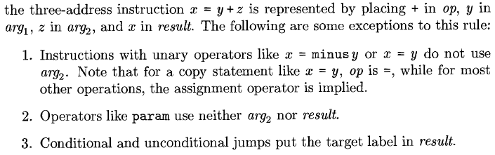
Quadruples
A quadruple is a record structure with four fields – op, arg1, arg2, and result
Op field contains an internal code for the operator
The contents of the fields arg1, arg2, and result are normally pointers to the symbol-table entries for the names represented by these fields
Temporary names must be entered into the symbol table as they are created.

Slide 34
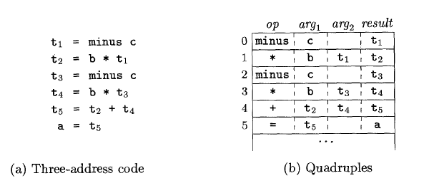
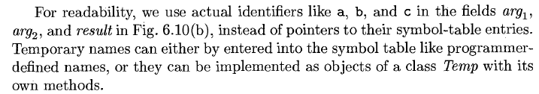

Slide 35
Triples
To avoid entering temporary names into the symbol table, we might refer to a temporary value by the position of the statement that computes it
The three-address statements can be represented by records with only three fields: op, arg1, and arg2
The fields arg1 and arg2 for the arguments of op are either pointers to the symbol table (for programmer-defined names or constants) or pointers into the triple structure (for temporary values)
Since three fields are used, this intermediate code format is known as triples.

Slide 36
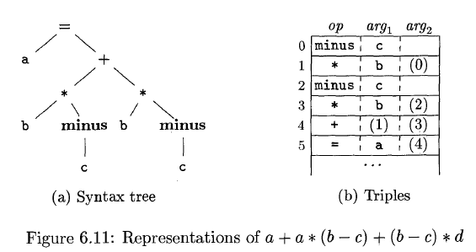

Slide 37
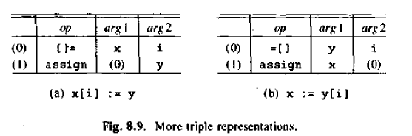

Slide 38
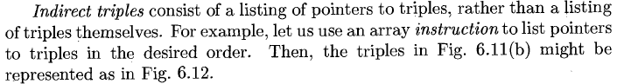
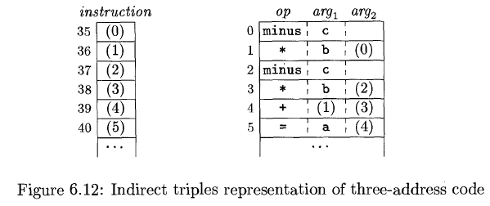

Slide 39
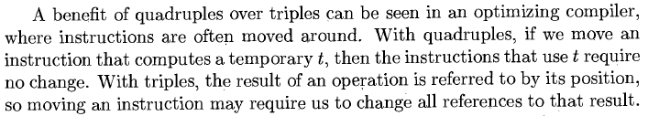
Comparison of Representations: The use of indirection
Quadruple – a three-address statement defining or using a temporary can immediately access the location of that temporary via the symbol table

Slide 40
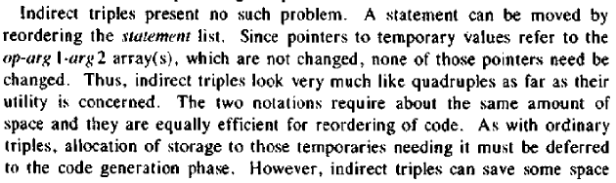
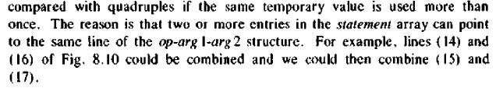
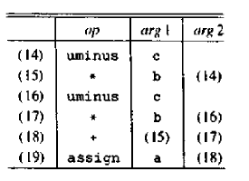

Slide 41
3AC
t1 = a-b Syntax tree -
t2 = c-d *
t3 = a + b - - +
t4 = t1*t2 a b c d a b
t5 = t4-t3
Quadruples
Triples
Indirect Triples
 | Op | Arg1 | Arg2 | result
(0) | - | a | b | t1
(1) | - | c | d | t2
(2) | + | a | b | t3
(3) | * | t1 | t2 | t4
(4) | - | t4 | t3 | t5
 | Op | Arg1 | Arg2
(0) | - | a | b
(1) | - | c | d
(2) | + | a | b
(3) | * | (0) | (1)
(4) | - | (3) | (2)
 | Statement
(10) | (0)
(11) | (1)
(12) | (2)
(13) | (3)
(14) | (4)

Slide 42
8.2 Declarations
As the sequence of declarations in a procedure or block is examined, the storage for names that are local to the procedure is reserved
For each local name, a symbol-table entry is created
Information such as the type and the relative address of the storage for the name is also stored
The relative address consists of an offset from the base of the static data area or the field for local data in an activation record

Slide 43
When the front end generates addresses, it may have a target machine in mind.
Suppose that addresses of consecutive integers differ by 4 on a byte-addressable machine
The address calculations generated by the front end may therefore include multiplications by 4

Slide 44
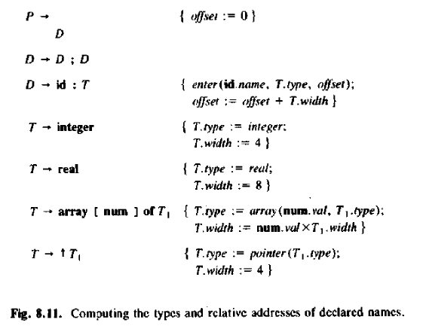

Slide 45
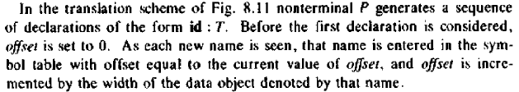

Slide 46
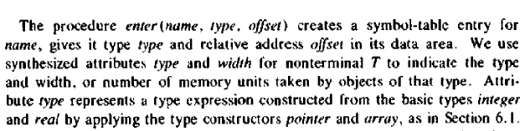

Slide 47
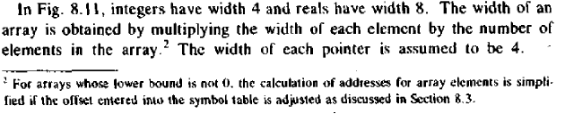

Slide 48
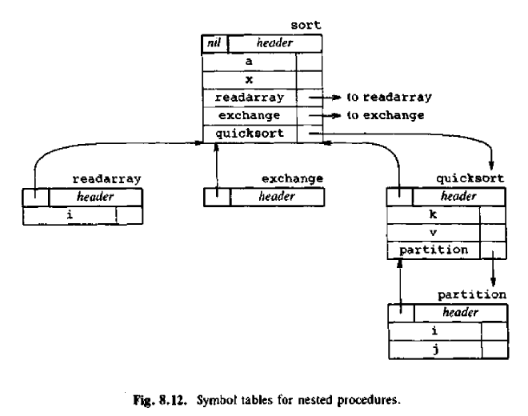
Keeping track of scope information

Slide 49
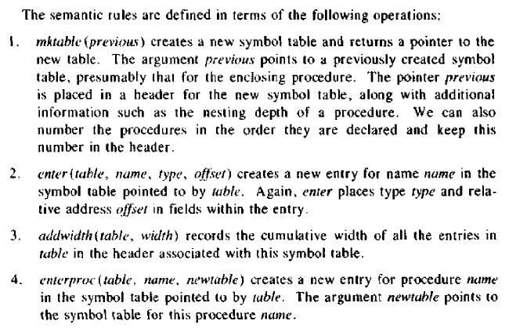

Slide 50
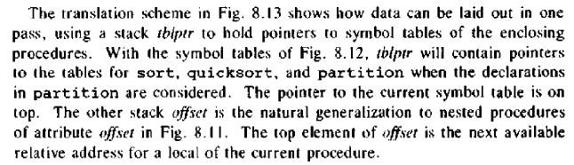
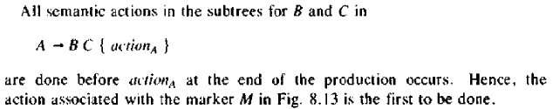

Slide 51
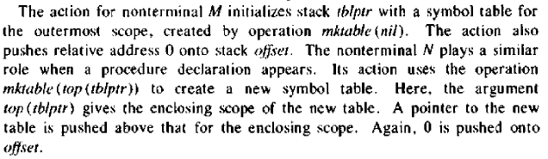
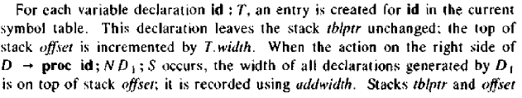
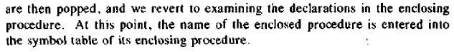

Slide 52
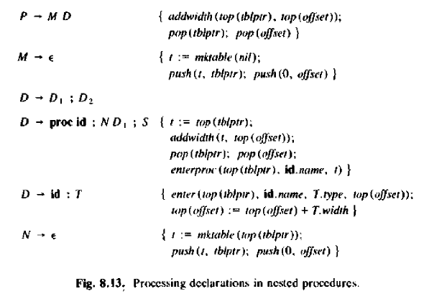

Slide 53
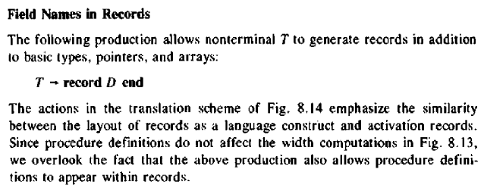

Slide 54
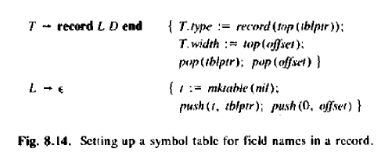

Slide 55
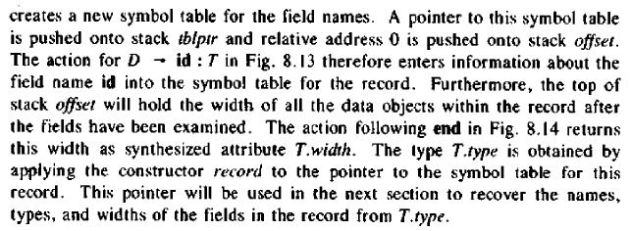

Slide 56
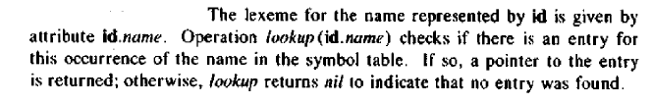

8.3 Assignment Statements

Slide 57


Slide 58
Reusing Temporary names
Assumed that newtemp generates a new temporary name each time a temporary is needed
Temporaries can be reused by changing newtemp

Slide 59

Addressing Array Elements

Slide 60


Slide 61


Slide 62

The translation scheme for addressing array elements

Slide 63
A[I,J]
Let A be a 10 x 20 array with low1=low2=1
n1 = 10, n2 = 20, w = 4 = width of each array element
(i1 x 20) + i2) x 4 + (base - (( 1 x 20) + 1) x 4)
(20i1 + i2) x 4 + (base - ( 20 + 1 ) x 4)
(20i1 + i2) x 4 + (base - (21 x 4))
(20i1 + i2) x 4 + (base - 84)
(base - 84) + (20i1 + i2) x 4

Slide 64

Type Conversions within Assignments

Slide 65
8.4 Boolean expressions
Boolean expressions have two primary purposes:
To compute logical values
Used as conditional expressions in statements that alter the flow of control

Slide 66
Methods of translating Boolean Expressions
Two principal methods of representing the value of a Boolean expression
To encode true and false numerically and to evaluate a Boolean expression analogously to an arithmetic expression
By flow of control, that is, representing the value of a Boolean expression by a position reached in a program

Slide 67

Numerical Representation

Slide 68




Slide 69


Slide 70


Slide 71



Short-circuit code

Slide 72



Slide 73


Flow-of-Control statements

Slide 74


Slide 75


Slide 76


Control-Flow translation of Boolean Expressions

Slide 77


Slide 78

Mixed-mode Boolean Expressions

Slide 79




Slide 80


8.5 Case statements

Slide 81


Syntax-directed translation of Case statements

Slide 82



Slide 83

8.7 Procedure calls

Slide 84


Slide 85



Slide 86


Questions

Slide 87


Slide 88
Questions
The End
of
Intermediate Code Generation

Slide 89
Chapter 7: Run-Time Environments
Aim: To relate the static source text of a program to the actions that must occur at run time to implement the program
Name in source text denotes data object in the target machine
As execution proceeds, the same name in the source text can denote different data objects in the target machine
Run-time support package manages the allocation and deallocation of data objects
This chapter examines the relationship between names and data objects

Slide 90
Run-time support package consists of routines loaded with the generated target code
The design of the run-time package is influenced by the semantics of procedures
Each execution of a procedure is referred to as an activation of the procedure
An activation may manipulate data objects allocated for its use
The representation of a data object at run time is determined by its type

Slide 91
7.1 Source language issues
Suppose that a program is made up of procedures
Aim: distinguish between the source text of a procedure and its activations at run time
Procedures
Activation Trees
Control Stacks
The scope of a declaration
Bindings of Names

Slide 92
1. Procedures
A procedure definition is a declaration that associates an identifier with a statement
Identifier – procedure name
Statement – procedure body
A complete program is also treated as a procedure
Procedures that return values are called functions
Procedure is called when its name appears within an executable statement
A procedure call executes the procedure body

Slide 93
Note: procedure calls can also occur within expressions
Formal parameters – special identifiers appearing in a procedure definition
Actual parameters – arguments passed to a called procedure; they are substituted for the formals in the body

Slide 94



Slide 95
2. Activation Trees
Assumptions about the flow of control among the procedures during the execution of a program:
Control flows sequentially;
the execution of a program consists of a sequence of steps,
control is at some specific point in the program at each step
Each execution of a procedure starts at the beginning of the procedure body and eventually returns control to the point immediately following the place where the procedure was called.
This means that the flow of control between procedures can be depicted using trees

Slide 96
Each execution of a procedure body is referred to as an activation of the procedure
The lifetime of an activation of a procedure ‘p’ is the sequence of steps between the first and last steps in the execution of the procedure body, including time spent executing procedures called by ‘p’, the procedures called by them, and so on.
In general, the term “lifetime” refers to a consecutive sequence of steps during the execution of a program
Each time control flows from an activation of a procedure ‘p’ to an activation of a procedure ‘q’, it returns to the same activation of ‘p’ (in the absence of a fatal error)
If ‘a’ and ‘b’ are procedure activations, then their lifetimes are either non-overlapping or are nested

Slide 97
A procedure is recursive if a new activation can begin before an earlier activation of the same procedure has ended
activation tree - depicts the way control enters and leaves activations
In an activation tree,
Each node represents an activation of a procedure
The root represents the activation of the main program
The node for ‘a’ is the parent of the node for ‘b’ if and only if control flows from activation ‘a’ to ‘b’, and
The node for ‘a’ is to the left of the node for ‘b’ if and only if the lifetime of ‘a’ occurs before the lifetime of ‘b’

Slide 98




Slide 99
3. Control Stacks
The flow of control in a program corresponds to a depth-first traversal of the activation tree
Traversal starts at the root, visits a node before its children, and recursively visits children at each node in a left-to-right order
A stack called the control stack is used to keep track of live procedure activations
Push node for an activation – when it begins
Pop node – when activation ends
Then the contents of the control stack are related to paths to the root of the activation tree.
When node ‘n’ is at the top of the control stack, the stack contains the nodes along the path from ‘n’ to the root.

Slide 100



Slide 101
4. The scope of a declaration
A declaration in a language is a syntactic construct that associates information with a name
Declarations may be explicit
E.g. in Pascal var i: integer;
or implicit
e.g. I in Fortran Ivar

Slide 102
There may be independent declarations of the same name in different parts of a program
The scope rules of a language determine which declaration of a name applies when the name appears in the text of a program
The portion of the program to which a declaration applies is called the scope of that declaration
An occurrence of a name in a procedure is said to be local to the procedure if it is in the scope of a declaration within the procedure; otherwise, the occurrence is said to be nonlocal

Slide 103
The distinction between local and nonlocal names carries over to any syntactic construct that can have declarations within it
At compile time, the symbol table can be used to find the declaration that applies to an occurrence of a name
As long as we are in the scope of the declaration, its entry is returned when the name in it is looked up

Slide 104
5. Bindings of names
Even if each name is declared once in a program, the same name may denote different data objects at run time
Data object corresponds to a storage location that can hold values
Environment refers to a function that maps a name to a storage location
State refers to a function that maps a storage location to the value held there
An assignment changes the state, but not the environment

Slide 105

An environment maps a name to an l-value (locations), and a state maps the l-value to an r-value (value)
An assignment changes the state, but not the environment
When an environment associates storage location ‘s’ with a name ‘x’, we say that ‘x’ is bound to ‘s’;
the association itself is referred to as a binding of ‘x’
If ‘x’ is not of a basic type, the storage ‘s’ for ‘x’ may be a collection of memory words

Slide 106


Slide 107


Slide 108
7.2 Storage organization
For languages such as Fortran, Pascal, and C.
Subdivision of Run-Time memory
Activation Records
Compile-time layout of local data

Slide 109

Subdivision of Run-time memory
Let the compiler obtain a block of storage from the OS for the compiled program to run in
This run-time storage might be subdivided to hold:
The generated target code
Data objects
Control stack to keep track of procedure activations

Slide 110
Target code
Size is fixed at compile time
So the compiler can place it in statically determined area
Data objects
Some of their sizes are fixed at compile time
So the compiler can place it in statically determined area
Static allocation – preferred so that the addresses of these objects can be compiled into the target code

Slide 111


As the program executes the stack and heap can change sizes

Slide 112



Slide 113
Heap –
separate area of run-time memory
Holds all other information
In C, malloc and free to obtains chunks of data storage (long lived data)
Stack-
Data is allocated and deallocated in a controlled way
Cheaper way to place data on the stack than the heap
Holds activation records

Slide 114


Slide 115



Activation Records

Slide 116
Returned value – field used by the called procedure to return a value to the calling procedure. Often returned in a register
Actual parameters – used by the calling procedure to supply parameters to the called procedure. Often passed in machine registers
Control link – points to the activation record of the caller
Access link – refers to nonlocal data held in other activation records
Saved machine status – holds information about the state of the machine just before the procedure is called. Includes values of the program counter and machine registers that have to be restored when control returns from the procedure
Local data – field that holds data that is local to an execution of a procedure
Temporary values – arising in the evaluation of expressions

Slide 117

Compile-Time Layout of Local Data
Suppose run-time storage comes in blocks of contiguous bytes
Byte is the smallest unit of addressable memory
Amount of storage for a name is determined from its type
Storage layout for data objects is influenced by the addressing constraints of the target machine
Example, instructions to add integers may expect integers to be aligned, i.e., placed at certain positions in memory such as an address divisible by 4
Space left unused due to alignment considerations is referred to as padding
Compiler may pack data so that no padding is left, additional instructions may then need to be executed at run time to position packed data so that it can be operated on as if it were properly aligned

Slide 118


Slide 119
7.3 Storage-allocation strategies
A different storage-allocation strategy is used in each of the three data areas in the organization
Static allocation lays out storage for all data objects at compile time
Stack allocation manages the run-time storage as a stack
Heap allocation allocates and deallocates storage as needed at run time from a data area known as a heap

Slide 120
Static Allocation
Names are bound to storage as the program is compiled
Every time a procedure is activated, its names are bound to the same storage locations
This property allows the values of local names to be retained across activations of a procedure
The addresses at which information is to be saved when a procedure call occurs are known at compile time

Slide 121
Limitation of using static allocation alone:
The size of a data object and constraints on its position in memory must be known at compile time
Recursive procedures are restricted, because all activations of a procedure use the same bindings for local names
Data structures cannot be created dynamically, since there is no mechanism for storage allocation at run time
E.g. Fortran was designed to permit static storage allocation

Slide 122
Stack allocation
Storage is organized as a stack
Activation records are pushed and popped as activations begin and end, respectively
Locals are bound to fresh storage in each activation
The values of locals are deleted when the activation ends

Slide 123


Slide 124
Calling sequences
Procedures are implemented by generating what are known as calling sequences in the target code
A call sequence allocates an activation record and enters information into its fields
A return sequence restores the state of the machine so the calling procedure can continue execution

Slide 125


Slide 126
Calling sequence:
The caller evaluates the actuals
The caller stores a return address and the old value of top_sp into the callee’s activation record. The caller then increments top_sp. top_sp is moved past the caller’s local data and temporaries and the callee’s parameter and status fields
The callee saves register values and other status information
The callee initializes its local data and begins execution

Slide 127
A possible return sequence is :
The callee places a return value next to the activation record of the caller
Using the information in the status field, the callee restores top_sp and other registers and branches to a return address in the caller’s code
Although top_sp has been decremented, the caller can copy the returned value into its own activation record and use it to evaluate an expression

Slide 128

Variable-length data
E.g. dynamically allocated arrays
The storage for these arrays is not part of the activation record, only a pointer to the beginning of each array appears in the activation record
Procedure ‘p’ has 3 local arrays. The storage for these arrays is not part of the activation record for p; only a pointer to the beginning of each array appears in the activation record.
The relative addresses of these pointers are known at compile time, so the target code can access array elements through the pointers

Slide 129
Dangling reference
A reference to storage that has been deallocated
Logical error since the value of deallocated storage is undefined according to the semantics of most languages
Since that storage may later be allocated to another datum, mysterious bugs can appear in programs with dangling references

Slide 130


Slide 131
Heap allocation
The stack allocation strategy cannot be used if either of the following is possible:
The values of local names must be retained when an activation ends
A called activation outlives the caller. This cannot occur for languages where activation trees correctly depict the flow of control between procedures
In each of the above cases, the deallocation of activation records need not occur in a last-in first-out fashion, so storage cannot be organized as a stack

Slide 132

Heap allocation parcels out pieces of contiguous storage as needed for activation records or other objects
Pieces may be deallocated in any order, so over time the heap will consist of alternate areas that are free and in use
If a retained activation record is deallocated, there will be free space in the heap.
It is left to the heap manager to make use of this space

Slide 133


Slide 134
Questions

Slide 135
Questions
The End
of
Run Time environments

Slide 136
Chapter 9: Symbol Tables
from Aho and Ulman ; Principles of Compiler Design; Narosa publishing House, ISBN: 81-85015-61-9

Slide 137


Slide 138
Significance of symbol table
Purpose – to provide a unique fixed-length encoding for the identifiers (and possibly the keywords) occurring in a program
Only a tiny fraction of the possible identifiers occur in a program
A shorter encoding suffices
Symbol table must uniquely map the identifier into this encoding
If the entire set of identifiers is not known a priori then such a mapping can be achieved only by comparing each input character string against those already encountered
Symbol table links machine addresses to source code items e.g. variables, procedures, or lines in a source file.

Slide 139
Compiler needs to collect and use information about the names appearing in the source program
This information is entered into a data structure called a symbol table
Information collected about a name includes:
String of characters by which it is denoted. And an indication of which block it belongs to
Type (int/real/string). Is it a label, formal parameter, array…
Form (simple/structure)
Location in memory, possibly an offset describing the position in storage to be allocated for the name
Other attributes depending on the language

Slide 140
Each entry in the symbol table is a pair of the form (name, information)
Each time a name is encountered, the symbol table is searched to see whether that name has been seen previously
If the name is new, it is entered into the table
Information about that name is entered into the table during lexical and syntactic analysis

Slide 141
Use of the information collected in the symbol table:
Semantic analysis – to check that uses of names are consistent with their implicit or explicit declarations
Code generation - to know how much and what kind of run-time storage must be allocated to a name
Code optimisation – to flag temporaries that are used more than once
Error detection and correction – to record whether an error message such as “variable A undefined” has been printed out before

Slide 142
Issues in the design of a symbol table
Format of the entries
Method of access
Place where they are stored
In block-structured languages:
the innermost occurrence of an identifier is always found first,
Names are removed from the active portion of the symbol table when they are no longer active

Slide 143
9.1 The contents of a symbol table
Symbol table as an ADT
Table with 2 fields
Name and information
Capabilities
Determine whether a given name is in the table
Add a new name to the table
Access the information associated with a given name
Add new information for a given name
Delete a name or a group of names from the table.

Slide 144
Chief alternatives to implement a symbol table are:
Linear list
slow to access but simple to implement
Tree structure
gives intermediate performance
Hash table
Fast but more complex

Slide 145

Names and Symbol-Table records
Simplest way to implement a symbol table is as a linear array of records
One record per name
A record normally consists of a known number of consecutive words of memory
This method is appropriate if there is a modest upper limit on the length of an identifier

Slide 146

If there is no limit on the length of an identifier e.g. ALGOL, PL/I
An indirect scheme is better
This indirect scheme permits the size of the name field in the symbol table itself to remain a constant
In the record for DIMPLE there is:
a pointer to another array of characters (the string table), and
A count (6) giving the length of the identifier
The pointer gives the position of the f first character of the identifier

Slide 147
This use of indirection can save space in representing identifiers over the alternative of allocating in each symbol-table entry the maximum possible amount of space

Slide 148
Reusing Symbol-Table space
The identifier used by the programmer to denote a particular name must be preserved in the symbol table until no further references to that identifier can possibly denote the same name
A compiler can be designed to run in less space if the space used to store identifiers can be reused in subsequent passes
The space taken by the string table could be used for other purposes during subsequent passes of the compiler
When a name is declared external to the program being compiled, the corresponding identifier must be preserved

Slide 149

When a record is used to store identifiers the space can be reclaimed as follows
Use 2 arrays for storing records
If DIMPLE is the i^{th} name found, place it in words 2i-1 and 2i of array IDENTIFIERS
If 5 words are used for information, the attributes of DIMPLE will be found in words 5i-4 through 5i of array INFORMATION
The internal representation of DIMPLE is no longer a pointer to the symbol table, but an integer index ‘i’ can be used to access either array

Slide 150

Array Names
All subscript information can be placed in the symbol table record itself
E.g. ANS FORTRAN limits 3 dimensions, and the lower limit is 1

Slide 151

Ex. in PL/I
Number of dimensions is not limited
the upper and lower limits of a dynamically allocated array can be any expression evaluable at run time
Advantage of indirection: Type of information is applicable to only some entries ex. array. It allows for more efficient utilization of space if there is space for a pointer in the symbol-table entry

Slide 152
9.2 Data Structures for Symbol Tables
During compilation, the symbol table is searched every time an identifier is encountered
Data are added if a new name or new information about an existing name is discovered
The data structure should support the memory requirements and be efficient to search.

Slide 153
3 symbol-table mechanisms
Linear lists
Trees
Hash tables

Slide 154
i) List (linear/sequential) of records
Simplest scheme to implement
Performance becomes poor when m-inquiries and n-entries get large
Search for a symbol from beginning of list up to the last entry
When the name is located, the associated information can be found in the words following next
Add a symbol following an unsuccessful search to the first free entry in the table and update the value of ‘n’.

Slide 155

Delete a symbol either physically (shifting entries causes change in entry no.) or logical deletion (add info to indicate deletion)
To insert ‘n’ names and ‘m’ inquiries the total work is cn(n+m) where ‘c’ is a constant representing the time necessary for a few machine operations
Useful for small programs
Minimum possible space is taken

Slide 156
ii) Self-organizing list
Elements of the search data structure are not located in adjoining memory areas
Each entry contains one pointer ‘LINK’ to another entry.
First entry has a special pointer ‘FIRST’
Search in the order indicated by the link
When a name is referenced or its record is first created, the record for that name is moved to the front of the list by moving pointers
To add:
make a new record ‘p’ and
set it as the first entry in the list by setting ‘p’ to point where FIRST points and
let FIRST point to ‘p’.
To delete:
traverse the list to find the node ‘q’ to delete.
Maintain a reference to previous node of the list and let it point to the node that the ‘q’ was pointing to. Memory associated with the deleted node must be deallocated.

Slide 157

Search and find NAMEi,
remember the previous name NAME_{p}
Temporarily remove entry ‘i’ from the list by making LINKp point to where LINKi points
Make LINKi point where FIRST points (the current first element)
Move NAMEi to the front of the list by making FIRST point to NAMEi
Advantage: names referenced frequently will tend to be at the front of the list, where they will be found quickly
Notes:
Searching for NAME4

Slide 158
iii) Search Trees
More efficient approach
Two link fields LEFT, and RIGHT are added to each record
These fields link the records into a Binary Search Tree (BST)
Search by BST property NAME_{j} < NAME_{i} < NAME_{k}
Before adding check if LEFT or RIGHT is not NULL
Deletion as in BST –
if leaf then delete,
if there is one child make previous entry point to child,
if two children then copy the in-order successor in the position of the node to delete and delete the in-order successor using previous two cases.

Slide 159
Binary tree search routine to look for NAME in a BST, where ‘P’ is initially a pointer to the root
(1) while P ≠ null do
if NAME = NAME(P) then
/* NAME found, take action on success */
(3) else if NAME < NAME(P) then
P = LEFT (P) /* visit left child */
(4) else /* NAME(P) < NAME */
P = RIGHT (P) /* visit right child */
/* if we fall through the loop, we have failed to find NAME*/

Slide 160
If names are encountered in a random order, the average length of a path in the tree will be proportional to log n, where ‘n’ is the number of names
Since each search follows one path from the root, the expected time needed to enter ‘n’ names and make ‘m’ inquiries is proportional to (n+m)logn
If ‘n’ is greater that 50, there are clear advantages to the BST over the linear list and the self-organizing list
If efficiency is paramount, then use the hash table

Slide 161
iv) Hash Tables
Fast access
A Hash table and a storage table are used
The hash table contains ‘k’ words numbered 0, 1, … , k-1. ( k a prime number )
These words are pointers into the storage table to the heads of ‘k’ separate linked lists
Each record in the symbol table appears on exactly one of these lists.
Search by:
applying a hash function ‘h’ to NAME such that h (NAME) is an integer between 0 and k-1.
Record for NAME belongs to the list numbered h (NAME).
Compute h (NAME) and search that list only.
To add a record:
create a record at first available place.
Link that record to the beginning of the h (NAME)^{th} list.
To delete place a special mark in place of the deleted record.

Slide 162

Capability of performing ‘m’ accesses on ‘n’ names in time proportional to n(n+m)/k, for any constant ‘k’
Hash table is preferred especially if storage is not particularly costly
Hash function ‘h’
Distribute names uniformly among the k lists
Easy to compute for names consisting of strings of characters

Slide 163
9.3 Representing scope information
Ex. FORTRAN – scope of a name is a single subroutine
Ex. ALGOL – scope of a name is the block or procedure in which it is declared
Thus in the same program the same identifier may be declared several times as distinct names, with different attributes
It is the responsibility of the symbol table to keep different declarations of the same identifier distinct

Slide 164
Method :
Give a unique number to each program element that may have its own local data
A match occurs if the identifiers match character for character, and the associated number in the symbol-table entry is the number of a currently active block or subroutine
When the scope of the source program goes beyond the scope of a name, the compiler may erase the characters representing the name – share the space

Slide 165


Slide 166

FORTRAN

Slide 167


Slide 168

Symbol table organization
For ALGOL

Slide 169


Slide 170
Questions

Slide 171
Questions
The End
of
Symbol tables

Slide 172

Chapter 11 -Error Detection and Recovery
Compiler must be an effective communication device
It should deliver comments to the user in a language and manner the user can understand
Compiler should also be able to recover from errors

Slide 173
Each phase of a compiler expects its input to follow a certain specification ex. RE, grammar rules, type rules
When the input does not, the phase has detected an inconsistency or an error, which it should report to the user
In order to continue processing its input, the phase must recover from each error it detects
Errors can be classified, depending on which compiler phase detects them, as:
Lexical-phase
Syntactic-phase
Semantic-phase

Slide 174


Slide 175
The error detection and recovery portion of the compiler consists of:
Routines to recover from lexical and syntactic errors
Routine to detect semantic errors
Routine to print diagnostics – diagnostic routine communicates with the symbol table to avoid printing redundant messages
The message printer must defer its diagnostics until after a complete line of source text has been read and listed

Slide 176
After detecting and reporting an error, a phase can either repair the error or pass it along to subsequent modules
If a phase attempts repair, it should take precautions that the repair does not introduce other errors
If a phase transmits errors without repair, then all subsequent phases should be prepared to deal with the erroneous inputs passed along

Slide 177
11.2 Lexical-Phase errors
E.g. misspelling an identifier, keyword, or operator
If after some processing, the lexical analyzer discovers that no prefix of the remaining input fits the specification of any token class,
Then it can invoke an error-recovery routine that can take a variety of remedial actions
Skip erroneous characters until the lexical analyzer can find another token
Use minimum-distance matching to correct the spelling of a token – compute the minimum number of error transformations required to transform the erroneous program into one that is syntactically well-formed
An erroneous program has ‘k’ errors if the shortest sequence of error transformations that will map it into some valid program has length ‘k’

Slide 178
Error recovery strategies:
Panic mode – delete successive characters from the remaining input until the lexical analyser can find a well-formed token. May confuse the parser
Deleting an extraneous character
Inserting a missing character
Replacing an incorrect character by a correct character
Transposing two adjacent characters

Slide 179
11.3 Syntactic-Phase Errors
E.g. an arithmetic expression with unbalanced parentheses
Much of error detection and recovery is centered around the syntax analysis phase
A parser detects an error when it has no legal move from its current configuration, which is determined by its state, its stack contents and the current input symbol
The stream of tokens coming from the lexical analyser disobeys the grammatical rules defining the programming language
To recover from an error a parser should ideally locate the position of the error, correct the error, revise its current configuration, and resume parsing

Slide 180
Goals of the error-handler in a parser:
Report the presence of errors clearly and accurately
Recover from each error quickly enough to be able to detect subsequent errors
Should not significantly slow down the processing of correct programs

Slide 181
LL and LR parsing methods have the viable-prefix property – they detect that an error has occurred as soon as they see a prefix of the input that is not a prefix of any string in the language
Classification of errors:
60% punctuation – e.x. comma in place of the semicolon
20% operator and operand – e.x. typing wrong operator
15% keyword – e.x. typographical error
5% other kinds – e.x. missing parenthesis

Slide 182
Error-Recovery Strategies
Panic-mode
Phrase level
Error productions
Global corrections

Slide 183
Panic-mode recovery
Simplest to implement
Can be used by most parsing methods
On discovering an error, the parser discards input symbols one at a time until a designated set of synchronizing tokens is found
Synchronizing tokens are usually delimiters, such as semicolon or end, whose role in the source program is clear
It is guaranteed not to go into an infinite loop
Adequate in situations where multiple errors in the same statement are rare

Slide 184
Phrase-level recovery
On discovering an error, a parser may perform local correction on the remaining input
i.e. replace a prefix of the remaining input by some string that allows the parser to continue
Examples of local correction (depends on the compiler designer):
Replace a comma by a semicolon
Delete an extraneous semicolon
Insert a missing semicolon
Replacement could lead to infinite loop: If something is always inserted on the input ahead of the current input symbol
Drawback: difficulty in coping with situations in which the actual error has occurred before the point of detection

Slide 185
Error productions:
If the common errors that might be encountered are known then augment the grammar for the language at hand with productions that generate the erroneous constructs
Then use the grammar augmented by these error productions to construct a parser
If an error production is used by the parser, then appropriate error diagnostics can be generated to indicate the erroneous construct that has been recognized in the input
E.x. YACC

Slide 186
Global correction
Ideally the compiler should make as few changes as possible in processing an incorrect input string
There are algorithms for choosing a minimal sequence of changes to obtain a globally least cost correction
Given an incorrect input string ‘x’ and grammar ‘G’, these algorithms will find a parse tree for a related string ‘y’, such that the number of insertions, deletions, and changes of tokens required to transform ‘x’ into ‘y’ is as small as possible.
However, these methods are in general too costly to implement in terms of time and space, so these techniques are currently only of theoretical interest

Slide 187
11.4 Semantic errors
E.g. an operator applied to an incompatible operand
A compiler must check that the source program follows both the syntactic and semantic conventions of the source language
This checking, called static checking ensures that certain kinds of programming errors will be detected and reported

Slide 188
Examples of static checks:
Type checks:
Compiler reports an error if an operator is applied to an incompatible
operand. The type of construct does not match that expected by its context.
E.g.
if an array variable is added to a function variable,
dereferencing is not applied to a pointer,
indexing is not done on an array,
user-defined function does not apply the correct number and type of
arguments (polymorphism – unification algorithm)

Slide 189
Flow-of-control checks:
Statements that cause flow of control to leave a construct must have some
place to which to transfer the flow of control,
ex. a break statement in C causes control to leave the smallest enclosing
‘while’, ‘for’, or ‘switch’ statement; an error occurs if such an enclosing
statement does not exist
Uniqueness checks:
There are situations in which an object must be defined exactly once,
ex. an identifier, labels in a case statement.
Name-related checks:
The same name must appear two or more times,
ex. in Ada, a loop or block may have a name that appears at the beginning
and end of the construct

Slide 190


Slide 191
Error recovery
Since type checking has the potential for catching errors in programs, the type checker must do something reasonable when an error is discovered
At least report the nature and location of the error
Desirable to recover from errors so that the rest of the input can be checked
Ex. once an error has occurred we may not know the type of the incorrectly formed program fragment -> because of missing information.
C++11 auto keyword

Slide 192
Questions

Slide 193
Questions
The End
of
Error detection and recovery

